Slide 1


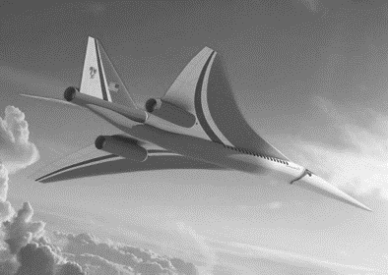
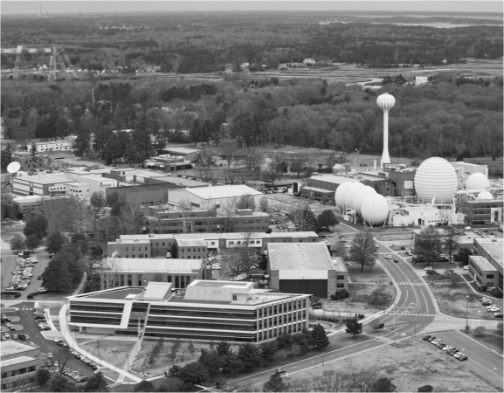
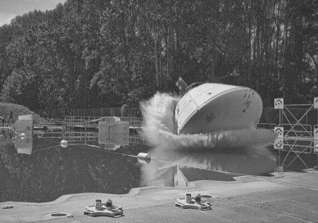
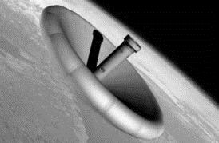
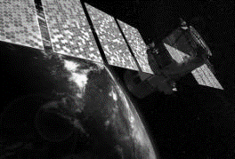
L A N G L E Y R E S E A R C H C E N T E R
O C I O D A T A S C I E N C E T E A M B R I E F I N G
Andy Ramlatchan
Senior Computer Scientist
OCIO Data Science Team
Notes:
Welcome.
Introductions.
Review Agenda

Slide 2

OCIO Data Science Strategy
Data Management
Knowledge Base
Machine Learning
Capture and curation of experimental, computational, and text data ensures accuracy
Effective data management supports discoveries within and across domains
A balanced approach to teaming, consultation, and education, to grow an embedded digitally-enabled workforce at Langley
Data-driven methods assist experts with interpretation, prediction, monitoring, and surrogate modeling
Artificial Intelligence will enable Virtual Research & Design Partners to help NASA achieve greater scientific discoveries and design optimizations

Slide 3

Data Science Team Composition
Effective teaming to solve problems in complex NASA domains
Our team background:
Applied Mathematics
Computer Science
Computer Engineering
Data Analytics
Our academic partners:
Georgia Tech
Old Dominion
Virginia Tech
Our industry and government partners:
IBM
AWS
SAIC
Splunk
US Army TRADOC
US Navy SPAWAR
Jefferson Lab
ARC, GRC, GSFC, and HQ
Domain Expertise
Mathematics
Computer Science
…and we regularly collaborate with Langley SMEs in RD, SD, SACD, ED, OCFO, and NESC

Slide 4
OCIO Data Science Strategy
Area | Past | Present & Near Term | Future
Machine Learning | Aeroelastic Flutter Climate Models Booster Separation SansEC READ | Additive Manufacturing Crew State Monitoring Non Destructive Evaluation ATTRACTOR Office of the Chief Financial Officer IT Security | Autonomy Trajectory-Based Operations Cybersecurity Intelligent Systems Smart Center
Text Analytics & Expert Systems | Watson Content Analytics Pilot Advisor On-Demand Mobility | Watson Explorer Jargon-Enabled ASR | Open Source Platforms Supporting Technologies
Training & Education | Seminar Series | Workshops and Tutorials AI BlueSky | Widely-available capabilities and training
Philosophy | for customers |  | Balanced approach to Grow embedded workforce
Continue to
D O
D O
Work to
T E A M
D O
T E A M
C O N S U L T
Begin to
C O N S U L T

Slide 5
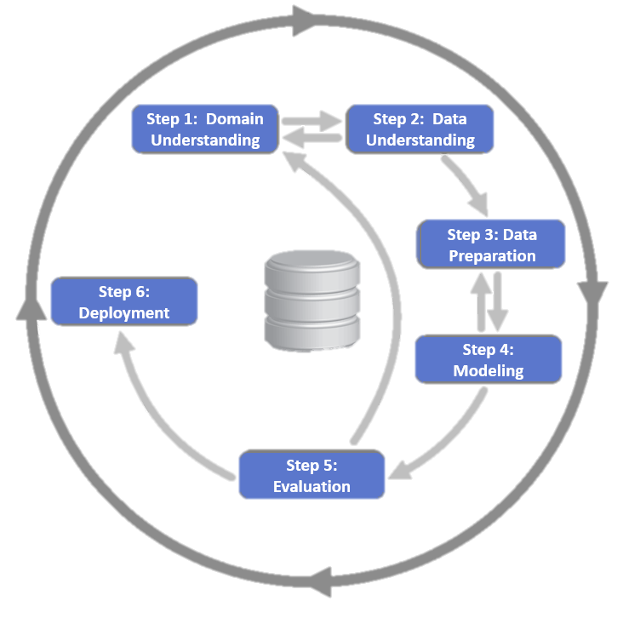
Data Science in NASA Domains
Knowledge Discovery in Databases
Extracting previously unknown information from data
Data Mining and Pattern Recognition
Application of specific algorithms for detecting patterns and relationships in data
Machine Learning
Classification or prediction, based on properties learned from training data
Reinforcement Learning
Machine learning that makes the optimal choice in a given situation, based on rewards
CRISP-DM

Slide 6
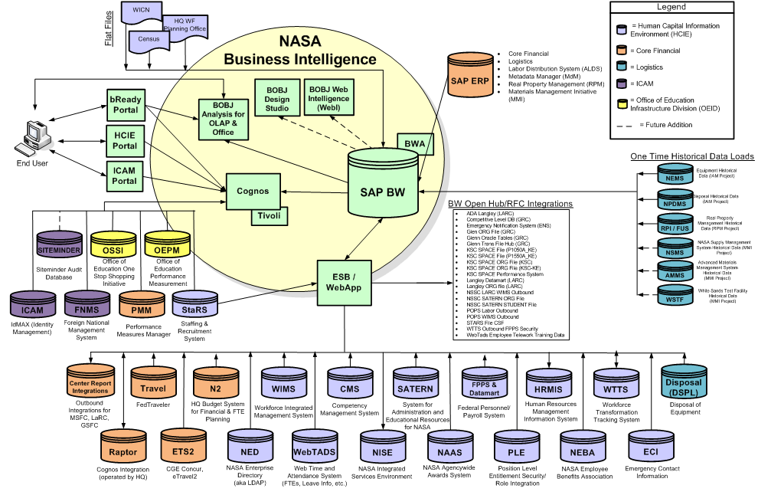
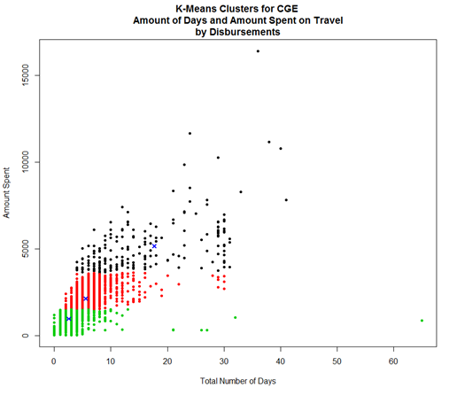
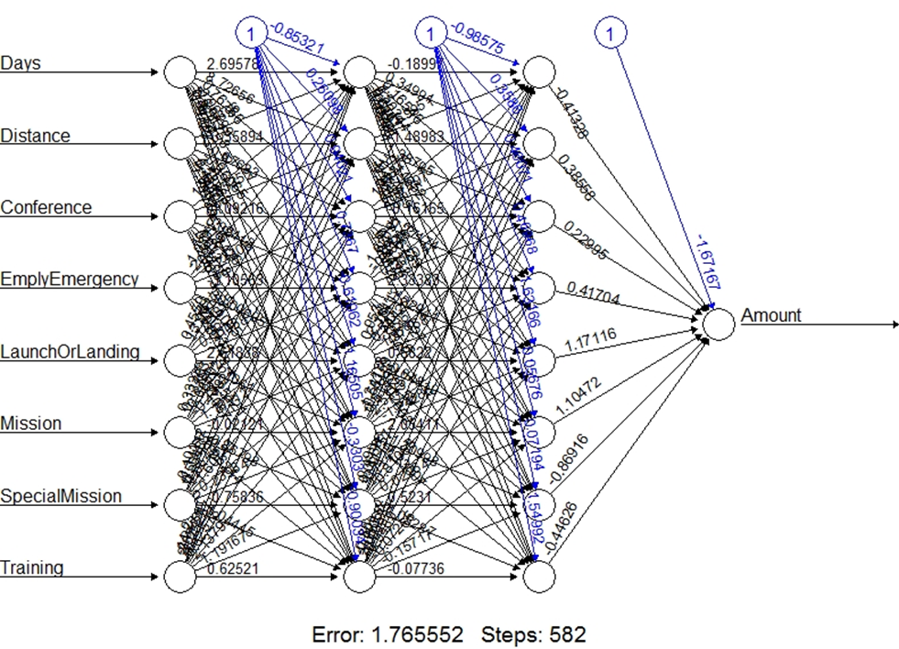
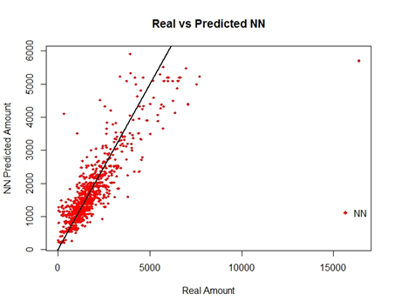
Use Case: Knowledge Discovery in Databases
OCFO Travel Systems Data Mining and Modeling
Approach:
Unsupervised learning for feature importance, followed by supervised learning approaches (e.g. a feed forward neural network to predict trip costs)

Slide 7
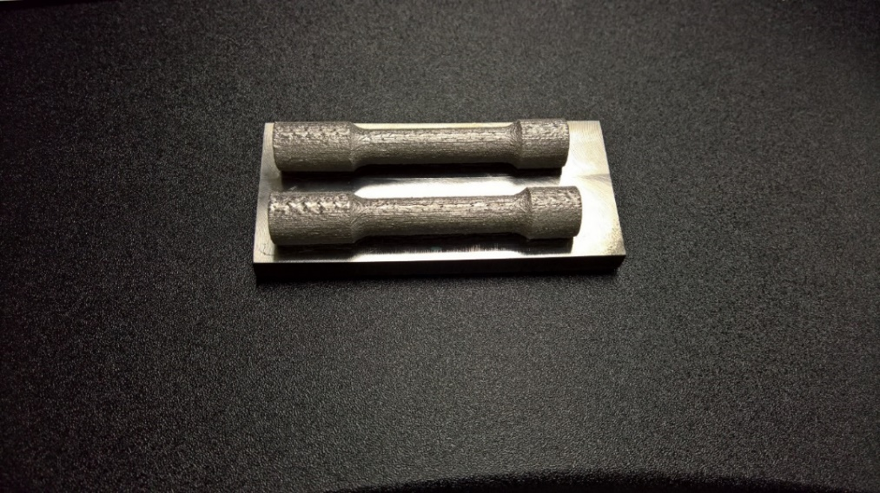
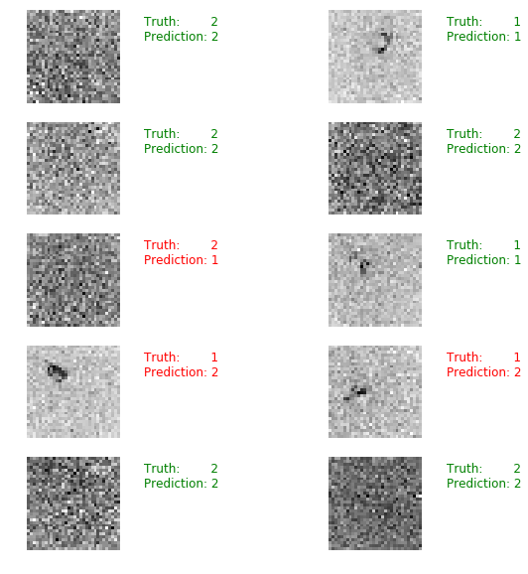
Use Case: Image Processing and CNN
Using machine learning to accurately classify defects in CT scans
Approach:
Convolutional Neural Network (CNN) used to identify the most important features and classify images
Used Python with Keras API and Tensorflow
Image files separated into two classes: “defect” and “non-defect” for training
Image preprocessing, cropping, scaling
Each class processed separately through CNN, and outputs concatenated
Dimensionality reduction identifies salient features
Non-Defect
Defect
Image from defect class now cropped to show just the center region and resized to 32x32
Image prediction where class 1 is “defect” and class 2 is “non-defect”

Slide 8
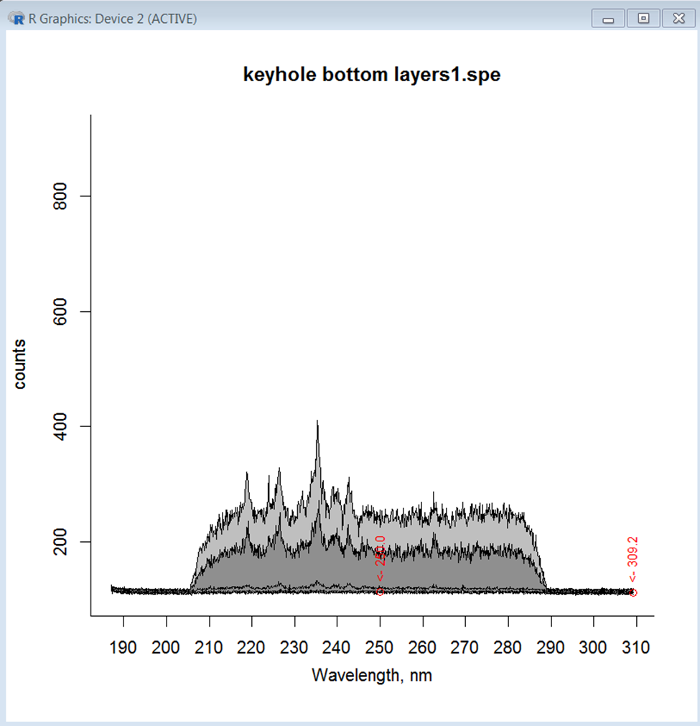
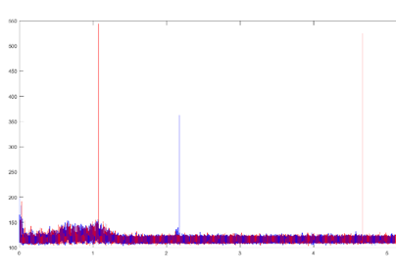
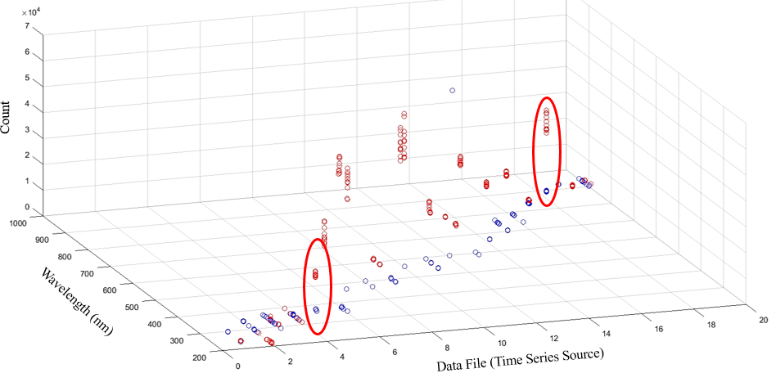
Use Case: Time Series Pattern Mining
Using data science to identify events in groups of spectra
Approach:
Transform raw spectra data into a time series model capturing all features
Time series represents wavelength and count
Filtering and peak identification reduce noise and isolate key events
Clustering can be applied to group similar events and identify patterns and significant events
Patterns can train additional machine learning methods for detection of undesirable events
Note the clustering (circled), in both Bottom and Middle measurements. The wavelength stays constant, but amplitude of count increases significantly, signaling a potential event of interest.

Slide 9
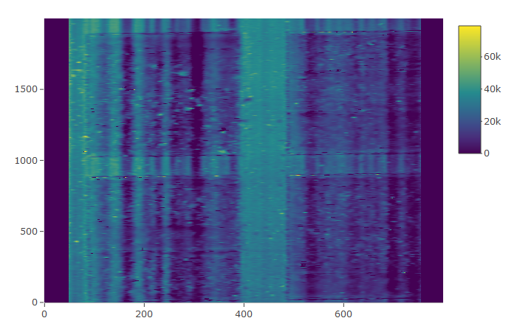
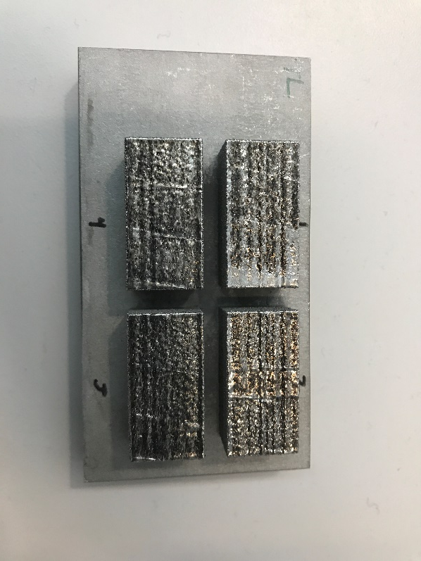
Use Case: Machine Learning for Signal Processing
Using matrix factorization to complete data sets filled with noise
Approach:
Using topology scans from laser line profilometry (LLP) captured in-situ from additive manufacturing build, missing data can be recovered
Topology of the surface of AM objects built represented in a 800x2000 matrix. Missing values (dark bands above) due to signal noise can be treated as a matrix completion problem

Slide 10
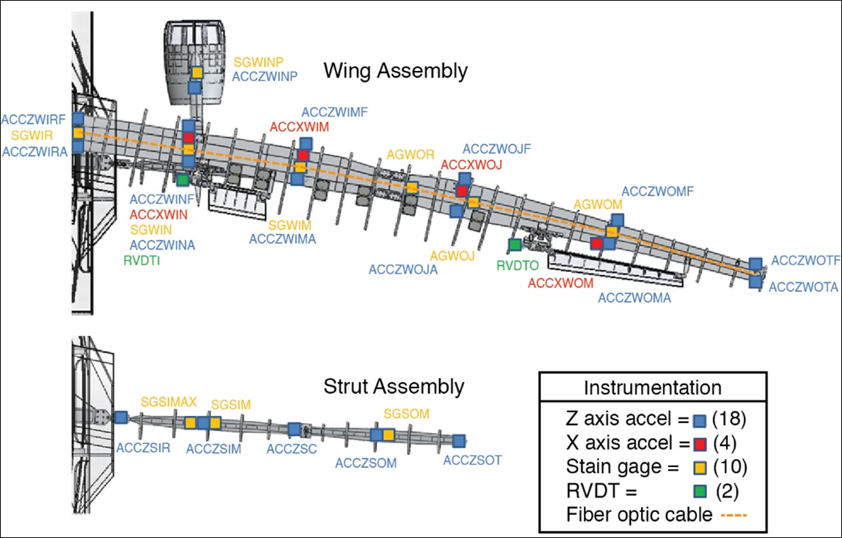

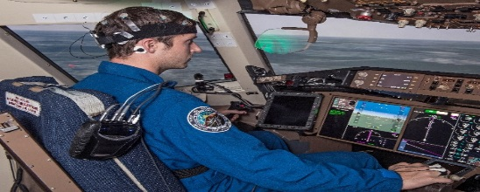
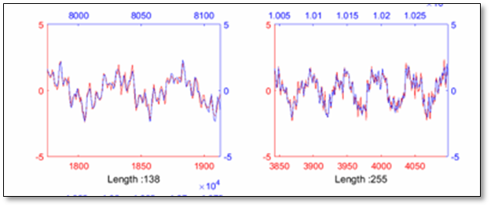
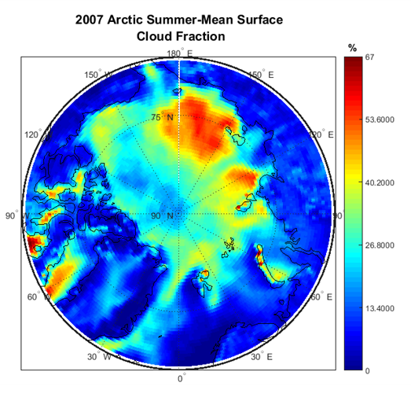
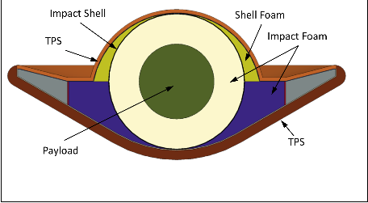
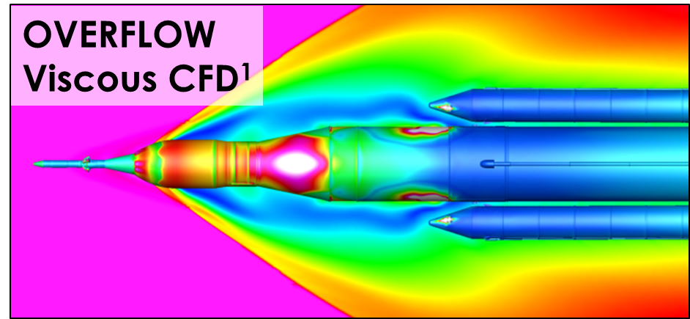
Data Science Use Cases 2014 - 2018
Knowledge Discovery in Databases
Efficient analysis of mod-sim data
Detecting deviations in travel patterns
Machine Learning
Detecting delaminations and cracks in carbon fiber
Predicting pilot cognitive state during flight
Defining areas of operability for aircraft
Improving climate science reanalysis models
Classifying sensor output to characterize dynamics
Complete missing data from noise in signal processing
Providing Value to NASA Researchers
Data Mining
Detecting patterns in wind tunnel data
Understanding the origin of defects in additively manufactured components
Reinforcement Learning
Exploring game theory
Methods for Autonomous Systems
T E A M
C O N S U L T
D O

Slide 11

Methods for Machine Learning Use Cases
Materials
Testing
Ensemble Learning
Statistical Algorithms
ATTRACTOR
Reinforcement Learning
Convolutional Neural Network
Defect Detection in Parts
Crew Cognitive State
Logistic Regression for Small Datasets
Aeroelastic Flutter; OCFO Travel Scorecard
SansEC Sensors
SLS Booster Database
Feed-forward Neural Network
Random Forests
Sequential Pattern Mining
Active Learning
Inlet Unstart
Cloud Fraction Models

Slide 12

Methods for Machine Learning Use Cases
Materials
Testing
Ensemble Learning
Statistical Algorithms
ATTRACTOR
Reinforcement Learning
Convolutional Neural Network
Defect Detection in Parts
MATLAB, Python
MATLAB, R, Python, C++
Python
Crew Cognitive State
Logistic Regression for Small Datasets
Caffe, TensorFlow
Aeroelastic Flutter; OCFO Travel Scorecard
SansEC Sensors
SLS Booster Database
Feed-forward Neural Network
Random Forests
R
Sequential Pattern Mining
Active Learning
MATLAB, R, Python
Inlet Unstart
Cloud Fraction Models
MATLAB, Python
MATLAB, R
MATLAB, R, Python

Slide 13
Final Thoughts
Team now has more than four years of experience in working complex aerospace challenges
Actively supporting Center and Agency strategies to embrace and advance machine learning
Assessing and recommending software and methods
Recognizing the hurdles in initial investment for the platforms needed for NASA’s mission, and recommending an optimal path forward
T E A M
C O N S U L T
D O

Slide 14
L A N G L E Y R E S E A R C H C E N T E R
Data Science Team
Questions?
Ed McLarney
Associate CIO for Technology & Innovation
OCIO Data Science Team Strategic Lead
Jeremy Yagle
AST, Data Analysis
OCIO Data Science Team Technical Lead
Andy Ramlatchan
Senior Computer Scientist
OCIO Data Science Team

